Slide 1
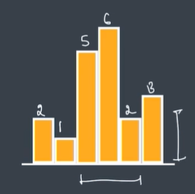
Problem statement
Given an array of integers heights representing the histogram’s bar height where the width of each bar is 1, return the area of the largest rectangle in the histogram.
Example:
Input: Heights=[2,1,5,6,2,3]
Output: 10

Slide 2


Histogrames.
A histogram is similar to bar graph which shows the frequency of numerical data using rectangles
Width of each bar is 1

Slide 3




Approach:
This problem can be approached by using stack data structure.
Stack is a linear data structure that follows a particular order in which the operations are performed. The order may be LIFO(Last In First Out) or FILO(First In Last Out). LIFO implies that the element that is inserted last, comes out first and FILO implies that the element that is inserted first, comes out last.
Rectangles that can form in the given histogram:

Slide 4
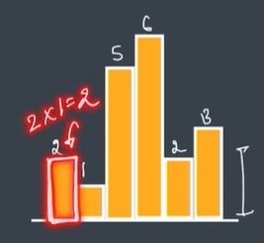
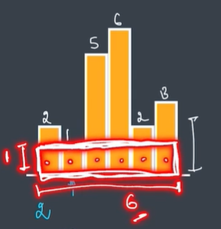
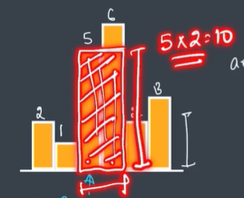
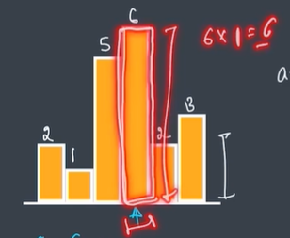
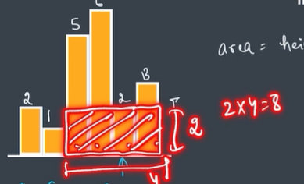
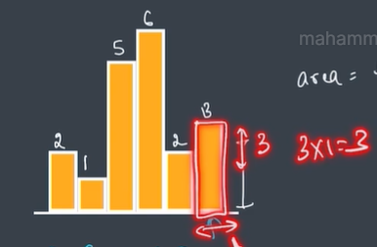
Area of rectangle = height * width
For area of rectangle to be maximum we should consider maximum possible values of height and width

Slide 5
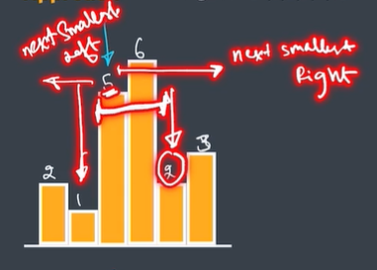
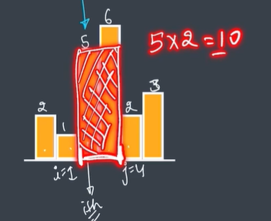
Approach in Detail(Mathematically Code Wise):
To find width we have to first find out left side next smaller index(i) and right side next smaller index(j)
For height 5(index 2)
Width=j-i-1
Width=4-1-1=2

Slide 6
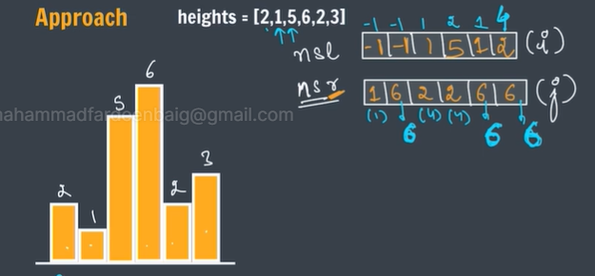
We should take into consideration n value(heights.length) if the next smaller right doesn't exist for any height.
We should take -1 into consideration if there is no next smaller left.

Slide 7
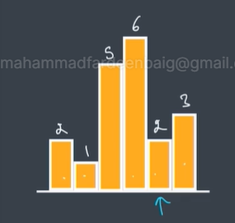
Heights=[2,1,5,6,2,3]
-1
-1
1
2
1
4
nsl
-1 | -1 | 1 | 5 | 1 | 2
1
6
4
4
6
6
nsr
1 | 6 | 2 | 2 | 6 | 6

Slide 8
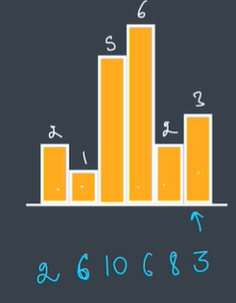
Area = 2 * (1+1-1) = 2 * 1 = 2
Area = 1 * (6 + 1 - 1) = 1*6 = 6
Area = 5 * (4 – 1 - 1) = 5*2 = 10
Area = 6 * (4-2-1) = 6*1 = 6
Area = 2 * (6-1-1) = 2*4=8
Area = 3 * (6-4-1) = 3*1=3

Slide 9
